Slide 1
System Development Methods CT046-3-2
System Deployment Approaches

Slide 2
Topic & Structure of the lesson
System Deployment Strategies
Overview
Sub-Phases
Common Changeover Techniques

Slide 3
Learning Outcomes
At the end of the module, you should able to:
Explain the purpose, structure and scope of modern Information System Development Methodologies and select and justify appropriate methods of analysis, design and implementation for a particular component or application, be it traditional, multimedia or web based.

Slide 4
Key Terms you must be able to use
If you have mastered this topic, you should be able to use the following terms correctly in your assignments and exams:
System Deployment Plan
System Change-over Strategy

Slide 5
System Deployment
Activities that make a software system available for use
System is ready to be delivered to owner / customer
System fully tested and fully functional.
Production site / pre-deployment test
To conduct ‘Post-deployment’ test (on-site testing)
Owner / customer are informed about the deployment
aka; product release / launching.

Slide 6

System Deployment Plan
Determining Deployment Options
Where will the system / software will be delivered?
Packaging Software / Systems
What and how the components will be delivered to the users?
Deployment Scheduling
Inform stakeholders of deployment event, who and when?
System change-over strategies
How the old system will be replaced with new?
Integrating System Components
Installing equipment / connecting servers, etc
Post-Deployment (On-Site) Testing
Provide Training to users (if needed)

Slide 7
Determining Deployment Options (Where will the system be delivered?)
Upload to Web Server / Web Host
Website / web applications
Software patches / plug-ins, etc
Upload to Web Store
Mobile applications, games
Create digital medium - DVD
Off-shelf applications
Console games
Install in customer’s local servers
Customized Business Systems / applications
Security Systems
Database

Slide 8
Packaging Software / Systems (Operations to prepare a system for assembly and transfer to the customer site)
Converting / securing source codes
Preparing SETUP or INSTALL files
Compress files
Burn to installation disks
OR prepare to upload to server
Prepare User Manual
Prepare Technical Manual

Slide 9
Deployment Scheduling (Inform stakeholders of deployment event)
For cloud-based system
Plan to backup old system files in cloud
Plan upload / update new system to cloud (date, duration)
Plan ‘fall-back’ time
For local system installation at user’s place
Identify all stakeholders involved in deployment
Inform relevant users of installation date and time
Ask to backup all ‘old’ files
Standby system support personnel
Instruct local servers to be ‘off-line for maintenance’
Plan ‘Fall-Back’ time

Slide 10
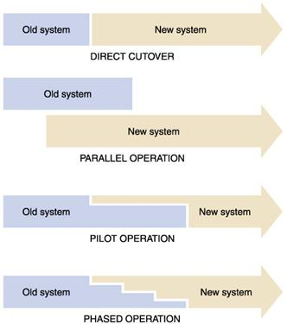
System Change-over Strategies (How the old system will be replaced with new?)

Slide 11
Integrating System Components (Installing equipment / connecting servers, etc)
Connecting sub systems to main systems
Connecting database
Connecting new system to other local system (legacy systems)
Installing security components
Firewall
User profiles (administrator access)

Slide 12
Post Deployment (On-Site) Test
Running test to spot new problems after deployment
Develop Test
Technical Tests
Connections Tests
Security Tests
User Test
User Acceptance Test

Slide 13
User Training
Applicable for large / complicated systems.
Training Administrators
Content Management
Maintenance of the system
Training End-Users
Common User functions
Training Technical Support
Fixing common problems

Slide 14
Other Activities of System Deployment
License Activation
EULA (End User License Agreement)
Corporate License
Connecting new system to backup machines
Connecting to Disaster Recovery Centre (DR)

Slide 15
Question & Answer

Slide 16
Tutorial
What are the common problems that you would face during System Deployment.
Discuss how is deploying Websites and Web Applications different?
APU want to deploy new Websapace-3 to replace current Webspace-2. Explain how it will be done following the below change-over methods;
Direct Changeover
Parallel Changeover
Pilot Changeover
Phased Changeover

